Slide 1
WHEN EVERYTHING CHANGES
Faithful Through Every Season of the Journey
Roger Bough
Indiana
Beverly Upperman
Georgia

Slide 2
Devotion and Prayer
“Anchored through the Seasons”
Hebrews 13:8 (NKJV)
Hebrews 6:19 (NKJV)
Deuteronomy 31:8 (NKJV)

Slide 3
GROUP ACTIVITY
What has been a major detour, delay, distraction or disruption for you since becoming a Kairos volunteer?

Slide 4

WINTER SEASON
Hardship and Waiting

Slide 5
A Time for Everything
Winter often looks/feels lifeless, but roots deepen in winter
  Rest before renewal
  Permission to pause
  Listening instead of doing
APPLICATION:
Scripture: Psalm 46:10
Personal: God is at work all the time
Ministry: Resist the pressure to force growth
WINTER SEASON
Hardship and Waiting

Slide 6
What Can’t Be Seen
COVID
Hidden strengthening
Deeper more resilient growth
Clearing space for transformation
Anchoring for future storms
APPLICATION:
Scripture: Colossians 2:6-7
Personal: Invisibility is not absence
Ministry: Learn to insulate and not isolate
WINTER SEASON
Hardship and Waiting

Slide 7
What Is Happening
Quiet reorganization
Preparing for the next season
Finding comfort in the dark
Refining/reconnecting with our vision
APPLICATION:
Scripture: 2 Corinthians 4:1
Personal: Winter is God's workshop
Ministry: Seeing is not believing
WINTER SEASON
Hardship and Waiting

Slide 8
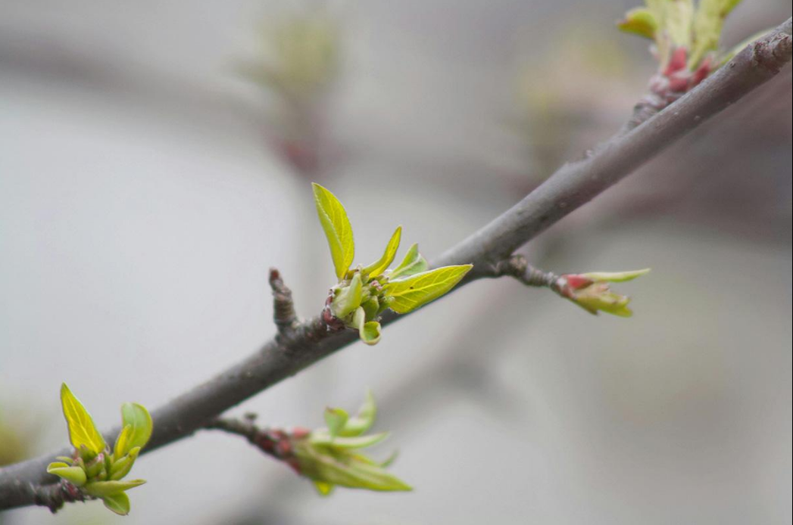
SPRING SEASON
Renewal and New Beginning

Slide 9
After The Waiting
Spring reminds us that resurrection is part of the journey
Spiritual renewal after a difficult (winter) season
Renewed hope after disappointment
Preparation for future fruitfulness
APPLICATION:
Scripture: Isaiah 43:19
Personal: Don't confuse sprouts with harvest
Ministry: Don’t move faster than God
SPRING SEASON
Renewal and New Beginning

Slide 10
A Time of Cultivation
New responsibilities that stretch you
Doors opening that previously seemed closed
New rhythms
APPLICATION:
Scripture: Song of Solomon 2:11-12
Personal: Embrace the new season
Ministry: Steward new opportunities wisely
SPRING SEASON
Renewal and New Beginning

Slide 11
A Word of Caution
Focus on roots and not just visible growth
Expecting immediate results
Don't lose the lessons of winter
Every challenge has not disappeared
APPLICATION:
Scripture: Hebrews 10:36
Personal: Maintain dependence on God
Ministry: Don’t relax spiritual vigilance
SPRING SEASON
Renewal and New Beginning

Slide 12
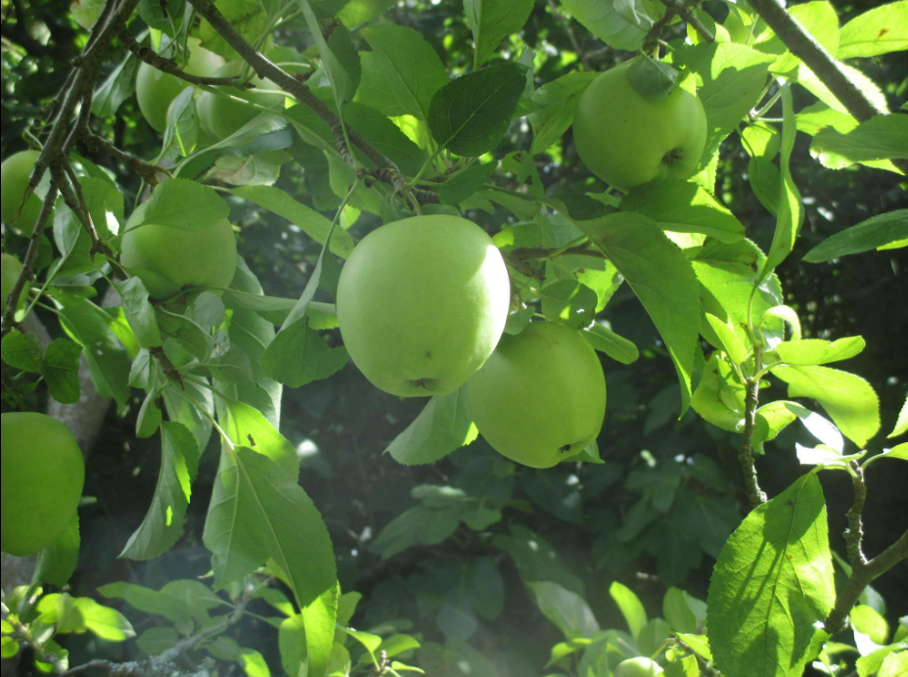
SUMMER SEASON
Fruitfulness and Momentum

Slide 13
SUMMER SEASON
Fruitfulness and Momentum
What Does It Look Like?
Longer Days
Productivity
Success
Growth
Cycles of the seasons in life & ministry
APPLICATION (CAUTION):
Personal: Don’t run ahead of the Lord
Ministry: Don’t step out of the Riverbanks

Slide 14
SUMMER SEASON
Fruitfulness and Momentum
Agriculture as a metaphor in Scripture
The soil, planting seeds, watering
Jesus’s Parable of the Sower
Psalm 1:1-3 (NKJV) Like a tree… bringing forth fruit in its season
John 15:4-5 “Abide in Me, and I in you…”
“I am the vine; you are the branches….”
APPLICATION:
Personal: daily, the three-legged stool
Ministry: intros, prayer groupings, fun

Slide 15
SUMMER SEASON
Fruitfulness and Momentum
Agriculture as a metaphor in Scripture
The rains; early & latter. Holy Spirit
Deuteronomy 11:14: "He will give the rain”
Joel 2:23; Hosea 6:3; Jeremiah 5:24
James 5:7: "Therefore be patient, … See how the farmer waits for the precious fruit …until it receives the early and latter rain.“
APPLICATION:
Personal: complete dependence on Him
Ministry: faith in His faithfulness 1 Cor 3:6-8

Slide 16

FALL SEASON
Transition and Release

Slide 17
FALL SEASON
Transition and Release
Can I Let It Go?
Some things must be released so new things can emerge (pyrophytes)
Trials can be an opportunity for growth
Producing Spiritual Fruit and Character
Maturing Our Faith (silver in the fire)
Ecclesiastes 3:1 “To everything…season”
APPLICATION:
Personal: forgiveness, letting go
Ministry: press (focus) toward the goal

Slide 18
FALL SEASON
Transition and Release
Fruits & the Harvest
Producing spiritual fruit & growth
Romans 5:3-5, Proverbs 17:3
The laborers and the harvest
Matthew 9:37-38, Galatians 6:9, John 4:35
But the fruit of the Spirit is love, joy, peace, longsuffering, gentleness, goodness, faith, meekness, temperance…
APPLICATION:
Personal: growth in Christ-likeness
Ministry: fruits of salvation

Slide 19
FALL SEASON
Transition and Release
More on the Harvest
Psalm 126:5-6"Those who sow in tears shall reap in joy. He who continually goes forth weeping, bearing seed for sowing, shall doubtless come again with rejoicing, bringing his sheaves with him."
Mark 4:29"But when the grain ripens, immediately he puts in the sickle, because the harvest has come.“
God provides the increase.
APPLICATION:
Personal: daily check our motives
Ministry: is the team on the right track

Slide 20
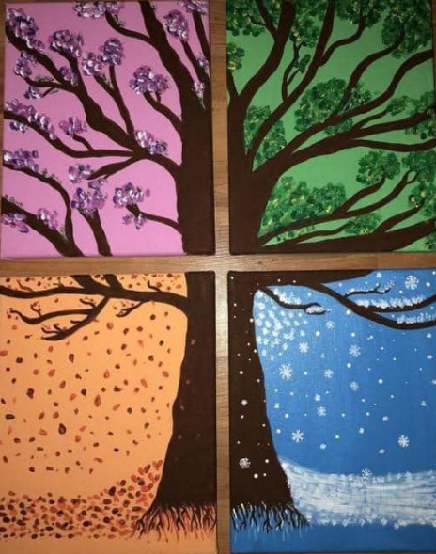
The Journey Continues
“Being confident of this, that He who began a good work in you will carry it on to completion until the day of Christ Jesus.”
Philippians 1:6 (NIV)
Seasons may change.
The mission/vision remain the same.

Slide 21
CLOSING THOUGHTS
Metaphors/Parables – Why does Jesus/Bible teach this way?
Revealing vs. Concealing, Fulfilling Prophecy,
Encouraging Pursuit of Truth, Making Deep Truths Relatable
When we are rooted in Christ, we can remain faithful through every season of the journey!
For 50 years, this ministry has endured many seasons—but through every season, God remained faithful.

Slide 22
Q&A
Final look at the Group Activity
Housekeeping; please turn in your forms
Closing Prayer; Thank you; Blessings

